Slide 1

Central Florida Education Industry Consortium
June 10, 2026 Meeting

Slide 2

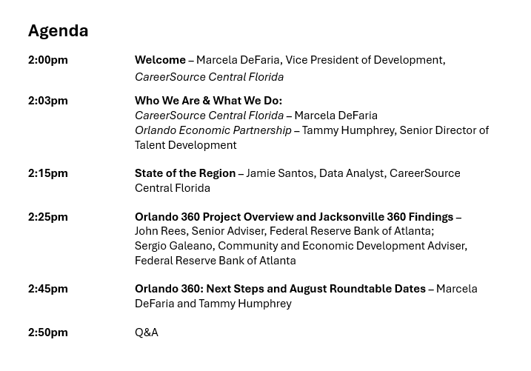

Slide 3
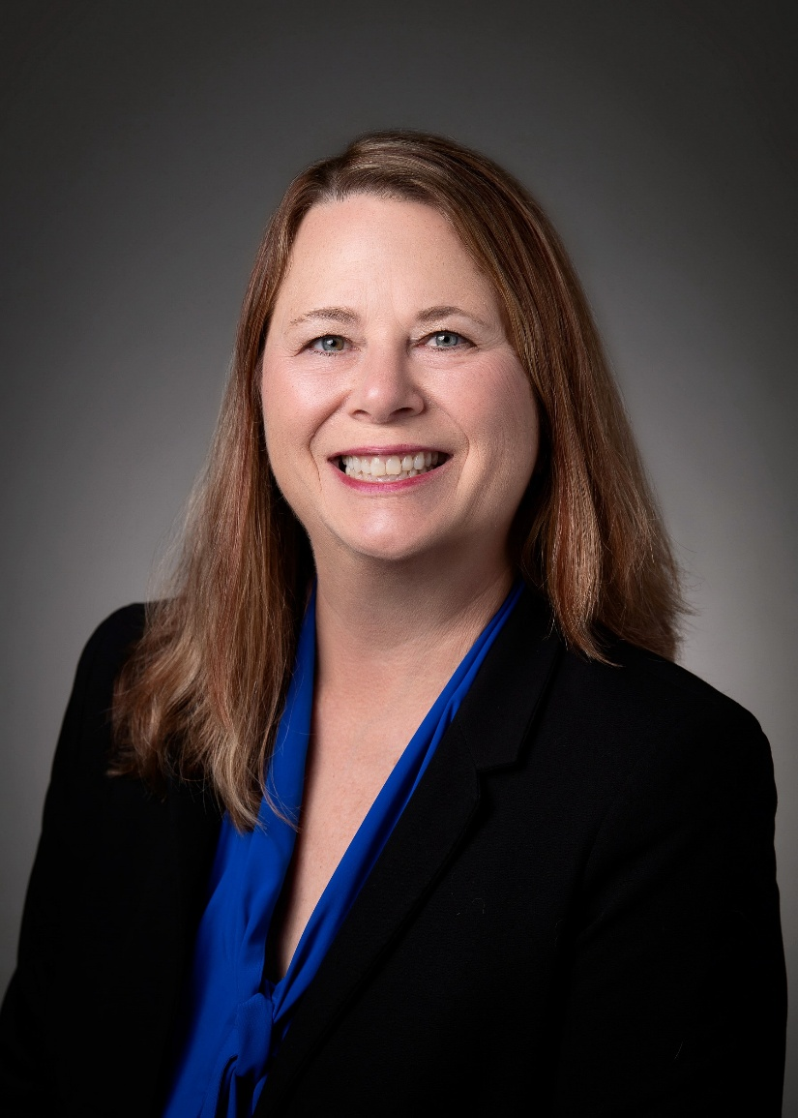



Who We Are & What We Do
Tammy Humphrey
Sr. Director, Talent Development
Marcela DeFaria
Vice President of Development

Slide 4

State of the Region
Jamie Santos, Data Analyst

Slide 5



PUBLISHED: MAY 2026
STATE OF THE REGION
BUSINESS INTELLIGENCE

Slide 6

CENTRAL FLORIDA DEMOGRAPHIC SNAPSHOT
POPULATION
GENDER
3,229,502
FEMALE: 50.9%
MALE: 49.1%
LABOR FORCE
MEDIAN AGE
1,566,960
40 Years Old
HOUSEHOLD INCOME
HIGH SCHOOL GRADUATION RATE
SIMPLE AVG OF ALL COUNTY MEDIAN HOUSEHOLD INCOMES
SCHOOL YEAR: 2024-2025
$80.0K
93.6%
Source: ACS Survey, Census via JobsEQ & Lightcast; Florida Department of Education
*Central Florida: Orange, Seminole, Osceola, Lake & Sumter Counties
Notes:
($38.46/hr)

Slide 7
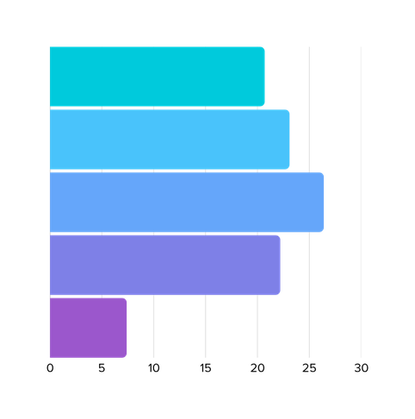
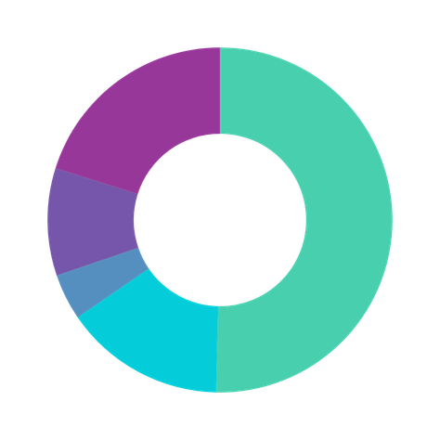
CENTRAL FLORIDA DEMOGRAPHIC SNAPSHOT
PREPARING TO RETIRE
VETERANS
WORKING POPULATION OLDER THAN 55
156,751
929,254
AGE DISTRIBUTION
RACE DISTRIBUTION
Under 18 Years
21%
Two or More Races
20%
18 to 34 Years
23%
35 to 54 Years
26%
32%
Other Race
10%
White
50%
Hispanic
55 to 74 Years
22%
Asian
4%
75+ Years
7%
Black or African American
15%
*Figures may not sum due to rounding.
Source: ACS Survey, Census via JobsEQ & Lightcast; Florida Commerce; The Florida Scorecard
*Central Florida: Orange, Seminole, Osceola, Lake & Sumter Counties

Slide 8
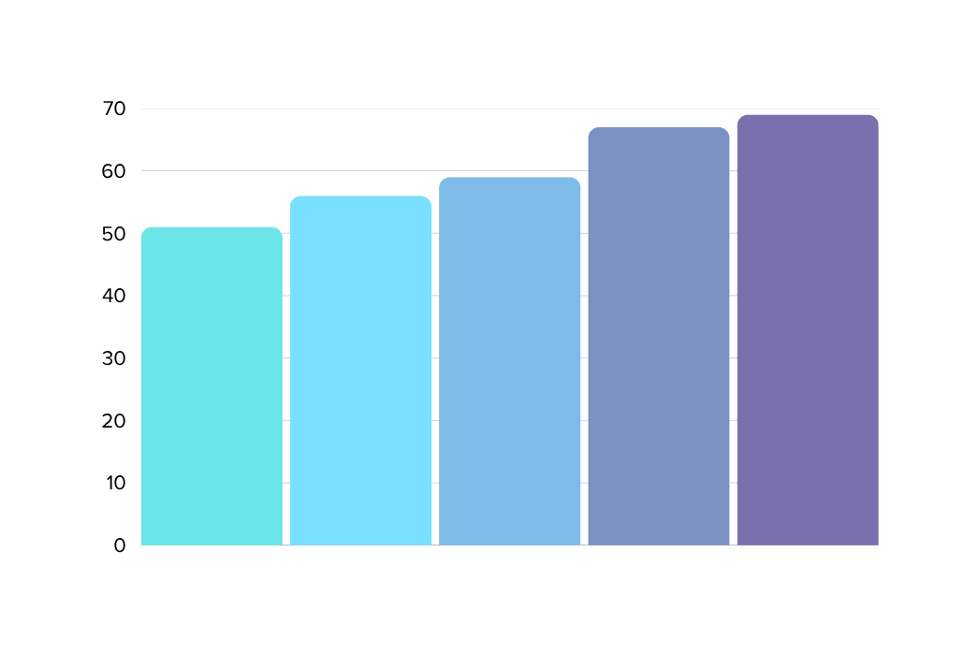
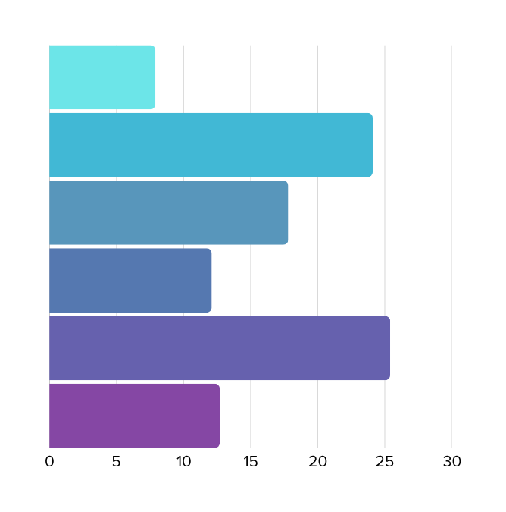
CENTRAL FLORIDA EDUCATIONAL SNAPSHOT
EDUCATIONAL ATTAINMENT
3RD GRADE READING SCORES
AGE 25 - 64
67%
69%
No High School
Diploma
7.9%
56%
59%
High School Graduate
24.1%
51%
Some College,
No Degree
17.8%
Associate
Degree
12.1%
Bachelor’s Degree
25.4%
Postgraduate Degree
12.7%
OSCEOLA
LAKE
ORANGE
SUMTER
SEMINOLE
Source: ACS Survey, Census via JobsEQ; Florida Commerce; The Florida Scorecard
*Central Florida: Orange, Seminole, Osceola, Lake & Sumter Counties

Slide 9
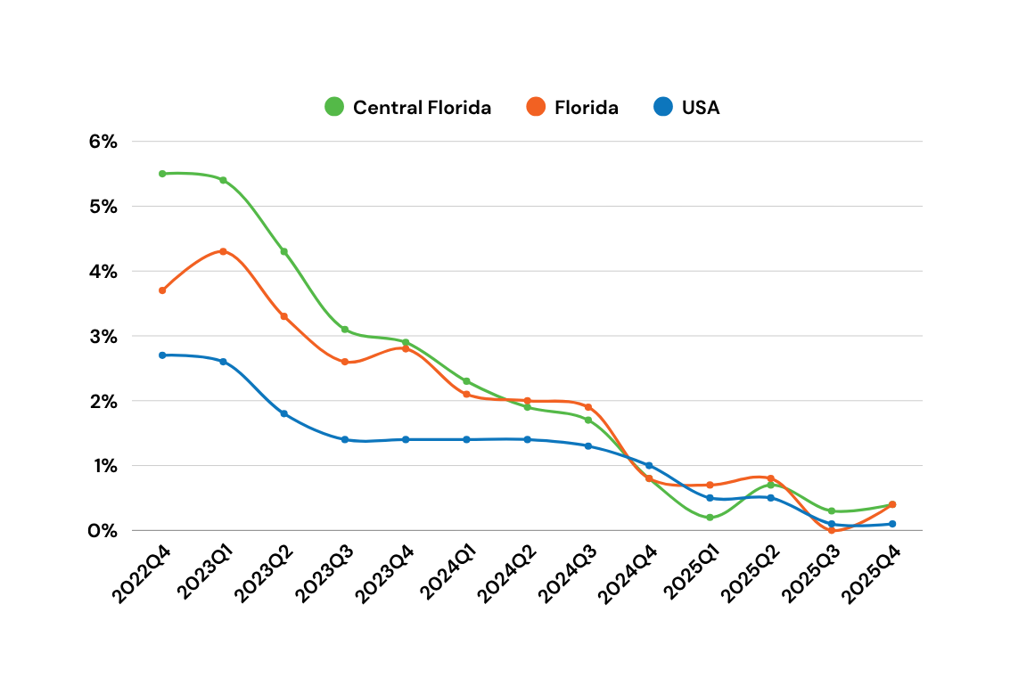
CENTRAL FLORIDA ECONOMIC SNAPSHOT
2025Q4
JOB GROWTH RATE
0.4%
0.4%
0.1%
STATE MINIMUM WAGE
FEDERAL MINIMUM WAGE $7.25/hr
$14.00/hr
LIVABLE WAGE
SINGLE NO KIDS (ORLANDO MSA)
$25.16/hr
MEDIAN WAGE
MEDIAN OCCUPATIONAL WAGE
$22.80/hr
Source: FL Commerce BLS, Economic Research via JobsEQ & Lightcast
*Central Florida: Orange, Seminole, Osceola, Lake & Sumter Counties

Slide 10
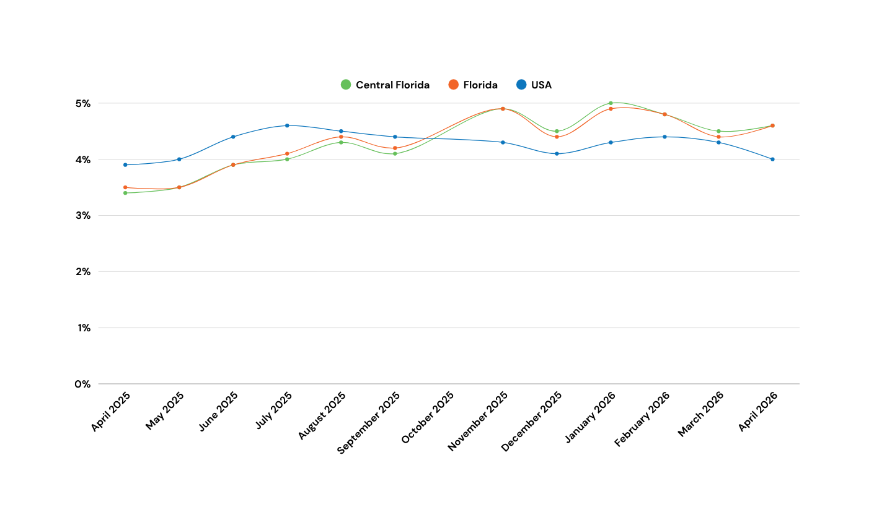
APRIL 2026
UNEMPLOYMENT RATE
CENTRAL FLORIDA
Unemployment Rate:
4.6%
Labor Force:
1,566,960
FLORIDA
Unemployment Rate:
4.6%
Labor Force:
11,147,000
UNITED STATES
Unemployment Rate:
4.0%
Labor Force:
169,548,000
PLEASE NOTE: OCTOBER 2025 DATA IS NOT AVAILABLE DUE TO GOVERNMENT SHUTDOWN IN 2025
Source: Florida Commerce; ACS Survey via JobsEQ; ACS Census
*Central Florida: Orange, Seminole, Osceola, Lake & Sumter Counties

Slide 11
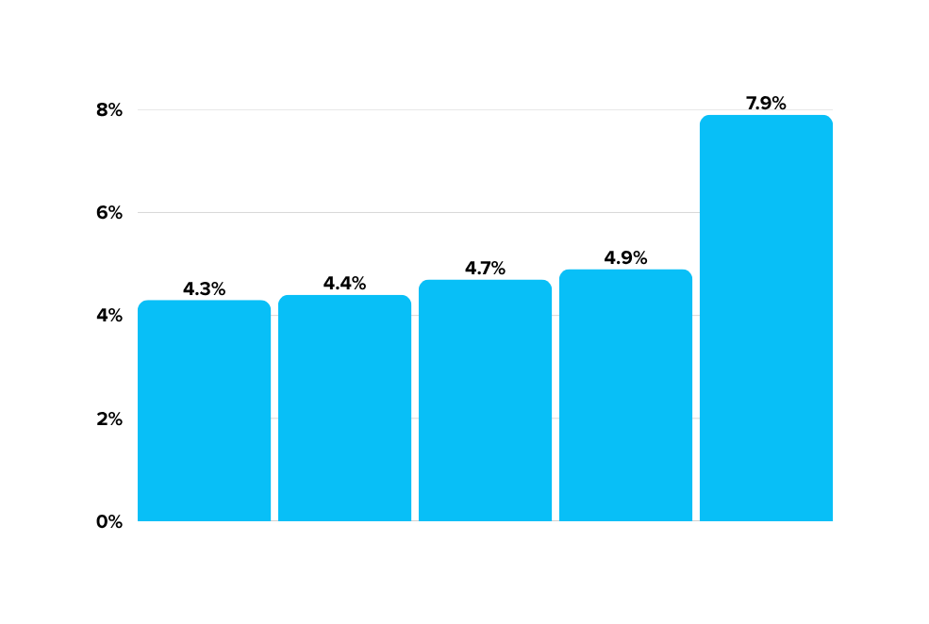
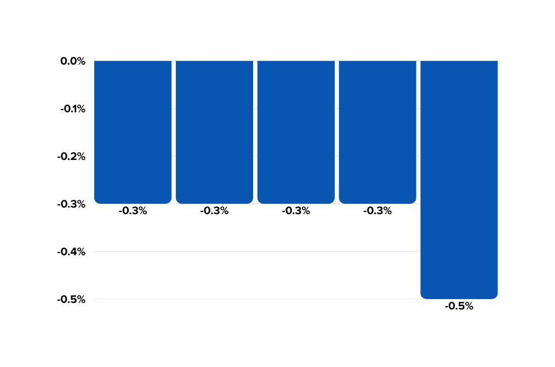
APRIL 2026
COUNTY BY COUNTY ECONOMIC SNAPSHOT
UNEMPLOYMENT RATE BY COUNTY
JOB GROWTH RATE BY COUNTY YOY
SEMINOLE
ORANGE
OSCEOLA
LAKE
SUMTER
SEMINOLE
ORANGE
OSCEOLA
LAKE
SUMTER
Source: Florida Commerce; Florida Scorecard
*Central Florida: Orange, Seminole, Osceola, Lake & Sumter Counties

Slide 12
CONSIDERATIONS TO ENTERING WORKFORCE
45%
$1,936
$13K
+0.8%
APRIL 2026
(512,321)
MOM% Change
Households are below the ALICE threshold
APRIL 2026
AVERAGE RENT
Average annual cost of child care for an infant
11.7%
+3.6%
(133,004)
$9,548
YOY % Change
Households living in poverty
$384K
33.3%
Typical home value/cost
Average annual cost of childcare for a
four-year-old
+24%
2020 - 2025
(379,317)
Households defined as ALICE
ALICE
Rent & Housing
Child Care in Florida
INFLATION
(Consumer Price Index)
(ASSET LIMITED,
INCOME CONSTRAINED, EMPLOYED)
SOUTH REGION
CENTRAL FL
CENTRAL FL
FLORIDA
Source: U.S. Department of Labor. Bureau of Labor Statistics, Zillow, Economic Policy Institute
*Central Florida: Orange, Seminole, Osceola, Lake & Sumter Counties
Notes:
379,317 households are ALICE - which are working households that earn above poverty but cannot afford basic necessities like housing, childcare, transportation, and healthcare.
That means 1 in 3 households (33%) in our region are ALICE.
Another 133,004 households (11.7%) live in poverty.
Combined, 45% of all households in Region 12 are struggling to make ends meet.

Slide 13


REGIONAL INDUSTRY DATA

Slide 14
CENTRAL FLORIDA TOP 5
BY EMPLOYMENT
INDUSTRIES
OCCUPATIONS
Accommodation and Food Services
Office and Administrative Support Occupations
Health Care and Social Assistance
Food Preparation and Serving Related Occupations
Retail Trade
Sales and Related Occupations
Administrative, Support and Waste Services
Transportation and Material Moving Occupations
Professional, Scientific and Technical Services
Management Occupations
Source: BLS QCEW via JobsEQ 2025Q4
*Central Florida: Orange, Seminole, Osceola, Lake & Sumter Counties

Slide 15
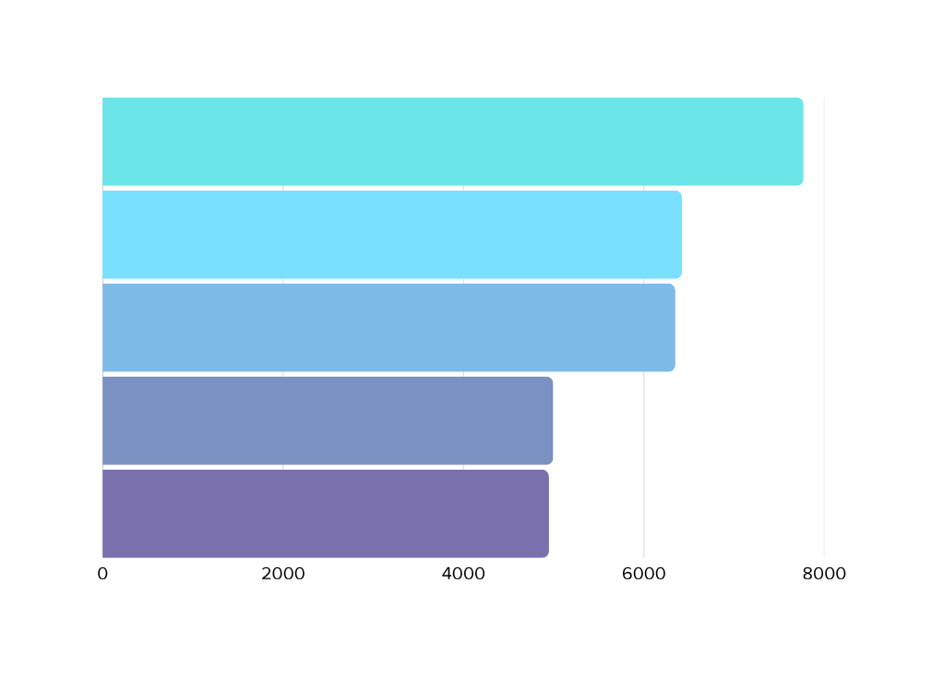
CENTRAL FLORIDA PROJECTED JOB GROWTH
3-YEAR PROJECTION
ESTIMATED NUMBER OF NEW JOBS EXPECTED.
THIS DOES NOT INCLUDE CHANGES DUE TO SEPARATIONS.
FOOD PREPARATION AND SERVING RELATED OCCUPATIONS
7,770
MANAGEMENT OCCUPATIONS
6,423
TRANSPORTATION AND MATERIAL MOVING OCCUPATIONS
6,349
HEALTHCARE PRACTITIONERS AND TECHNICAL OCCUPATIONS
4,995
SALES AND RELATED OCCUPATIONS
4,948
Source: BLS EMP via JobsEQ 2025Q4
*Central Florida: Orange, Seminole, Osceola, Lake & Sumter Counties

Slide 16
CENTRAL FLORIDA: YOY JOB POSTINGS
APR 2025 - APR 2026
UNIQUE POSTINGS
EMPLOYERS COMPETING
ADVERTISED SALARY
325,972
21,841
$24.06/hr
TOP 5 HIRING COMPANIES
TOP 5 POSTED OCCUPATIONS
APR 2025 - APR 2026
APR 2025 - APR 2026
AdventHealth
Registered Nurse
Orlando Health
Retail Salesperson
HCA Healthcare
Heavy and Tractor-Trailer Truck Drivers
Marriott International
First-Line Supervisors of Retail Sales Workers
Encompass Health
Customer Service Representatives
Source: Lightcast Job Posting Methodology
Notes:
1.7.2013
Median of advertised Wage has increased 9.3% since September 2022. From $19.75 to $21.60.
There is a declining trend in the Unique Postings number since Jan 2023.
‹#›

Slide 17
TAKEAWAYS
POPULATION IS AGING
Nearly 1 in 3 people are over 55
ECONOMIC PRESSURE
45% of Central Florida households live below the ALICE threshold
ESSENTIAL ROLES IN DEMAND
Healthcare & retail lead in job demand

Slide 18
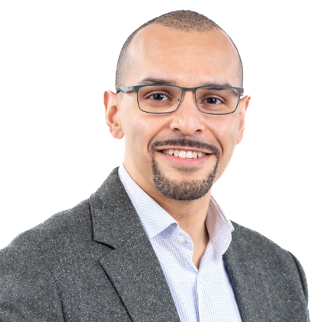


Orlando 360 Overview
Sergio Galeano, CED Adviser
John Rees, Senior Adviser

Slide 19

Orlando 360 Labor Market Conditions
Insights from Industry, Social Service Sector, and Workers or Jobseekers
The views presented are not necessarily those of the Federal Reserve Bank of Atlanta or the Federal Reserve System.

Slide 20
Orlando 360 Objective
Engage in a holistic approach to understand the perspectives on the labor market from all sides:
Assess workforce demand, talent needs, and hiring challenges facing employers and industry leaders;
Examine how training, workforce development, and support-service organizations prepare and connect talent to opportunity
Elevate the perspectives and experiences of workers and jobseekers navigating the job market.
Industry Perspective
Social Service Provider Perspective
Worker Perspective

Slide 21
360 Value Proposition
We are currently piloting a partnership between our Regional Economic Information Network and Community and Economic Development teams with communities across the Southeast.
This approach blends information gathering to serve a dual purpose:
1) to inform monetary policy analysis and research questions and;
2) to strengthen and inform regional alignment on labor market needs.

Slide 22
360 Process
Business
Roundtables
Focused on key economic driver industries in regional economy
Discussion on workforce needs, risks and opportunities
Reflection on preliminary worker and job seeker insights
Workforce and Social Service Roundtables
Focused on talent supply supporting organizations
Discussion on community needs, organizational and service delivery impacts and opportunities
Worker and Job Seeker Focus Groups
Identified through community-based organizations
Highlight worker experiences with employment and navigating the regional labor market

Slide 23
360 Orlando – Why Now and Why This Market?
Population Growth Among Metropolitan Areas with Populations of 2 Million +, 2020 - 2025
Employment Growth Among Metropolitan Areas with Populations of 2 Million +, 2020 - 2025
Orlando
Orlando

Slide 24
360 Outcomes
Data collection: roundtables and focus groups, interviews with critical voices will be conducted as needed
Data analysis: information synthesis, theme identification, potential strategies
Deliverables:
  Capstone presentation and discussion on community coordination
  Overview of findings in detailed presentation
  Publication from the Atlanta Fed on insights and outcomes – high level (Jacksonville example: Atlanta Fed Analysis of Jacksonville Job Market Reveals Regional Conditions - Federal Reserve Bank of Atlanta
  Longer-form write up of process and findings to community leaders

Slide 25
360 Community Partners
Working with two regional community organizations to set roundtables and engage with workers and job seekers:
Orlando Economic Partnership
CareerSource Central Florida*
In Jacksonville our core partner was the JAXUSA Partnership
Presented findings at the Talent Advancement Network quarterly meeting for a capstone discussion (CHROs and Workforce Organizational Staff)
*Shared worker outreach material with United Way Heart of Florida

Slide 26
360 Worker Engagement Process
Working through community-based organizations, we solicit interest from workers and job seekers to join virtual focus groups to share their experiences with employment and navigating the job market.
Workers and job seekers are compensated for their time and expertise.
We take data privacy very seriously. All data collected are de-identified and redacted in analysis and findings from their perspectives.
Focus groups are held during business and evening hours to accommodate different working and family schedules.

Slide 27
360 Worker Engagement Questions
Employment experiences and household costs:
Current and recent employment
Inflation and costs
Job change and looking for work
Opportunities and challenges in employment:
Challenges in employment
Gig work and self-employment
Education and skill development
Job quality and changes in the job market
Defining job quality
Employment requirements
Technology changes
Looking forward
Confidence in the job market
Future concerns
Future aspirations

Slide 28
Jacksonville360 Employer Themes
Current Environment Generally Favors Employers over Workers
Flexibility Versus Compensation
Significant Labor Differences Among Industries
Many firms have adopted “Survive 2025” mentality.
Labor market softening, advancing tech influencing slower, intentional hiring decisions and/or approaches to managing attrition.
Workers continue to place significant value on flexibility and work life balance.
Employers with front-office and back-office functions noted wage premiums for in-person roles and lower attrition for remote/hybrid roles.
Employers in areas such as construction and healthcare noted that hiring remained a challenge.
In contrasts, transportation and logistics companies have laid off workers in recent months.

Slide 29
Jacksonville360 Social Service Provider Themes
Slowing Job Market
Increased Need for Services
Reduced Capacity for Services
CareerSource NEFL noted decline in job orders from an average 3K monthly in 2024 to ~400 monthly in 2025.
Recent rise in WARN notices.
Recent vacancies due to budget constraints at many local non-profit organizations go unfilled.
Increased demand for services and need for referrals.
CareerSource NEFL customer based doubled in past year. Demographics are changing, notable rise in older individuals looking for work.
Many seeking assistance are employed (housing, food assist.)
Reduced state support for childcare is expected to result in 20% reduction in subsided childcare slots
Funding cuts are expected to result in layoffs at many non-profits.

Slide 30
Jacksonville360 Worker Themes
Cost of Living Concerns
Job Search Instability & Underemployment
Mixed Confidence, Frustration in Job Market
Food and childcare costs noted as major financial burdens.
Stricter household emphasis on budgeting, leveraging credit lines, pay-over-time, open marketplaces for goods/food.
Lack of responsiveness from employers on job applications.
Gig-work used to supplement income.
Sense of underemployment in current roles, concentration of entry level opportunities.
Sense of thankfulness when respondents were employed, even if underemployed.
Frustration finding suitable work with pay, location, flexibility.
"I'm the person that's using Klarna, I'm using Afterpay. Anything that will allow me to try to financially keep some cash flow in my account."
"I'm finding my title doesn't reflect the work I do, but I can't get a title change… So my title seems very entry level, but I'm not doing entry level work."
“I mean, there's a lot of investment coming. Or that's what we're being told. And so it should pan out for the long term. But being unemployed for almost a year I'm getting a little frustrated with it."

Slide 31
Findings
Childcare Affordability: Orange County
Selected One Earner Occupational Scenarios
(Household Proportion of Income Dedicated to Child Care)
Selected Two Earner Occupational Scenarios
(Household Proportion of Income Dedicated to Child Care)
Notes:
Value proposition:
Child care is an issue on the radar of employers and policymakers but without tangible information on the potential budget constraints that wages may impose for a significant portion of the workforce.
This research can shed light on the realities of household budget needs for working families and the implications for the recruitment and retention of workers.
This analysis can help inform community and economic development efforts, workforce development considerations, and employer practices.

Slide 32
360 Questions?
Please feel free to reach out to the Atlanta Fed Team:
John Rees: john.rees@atl.frb.org
Sergio Galeano: sergio.galeano@atl.frb.org
Sarah Miller: sarah.miller@atl.frb.org
Michelle Dennard: michelle.dennard@atl.frb.org

Slide 33
Orlando 360: Next Steps
June 30: Invitations for Participation
July-August: Selection of Participants Finalized
August 18 and 19: Roundtables at OEP

Slide 34
Orlando 360: Q&A

Slide 35
Thank You!
Tammy.Humphrey@orlando.org
John.Rees@atl.frb.org
Sergio.Galeano@atl.frb.org
MDeFaria@careersourcecf.com
JSantos@careersourcecf.com

